Slide 1

Module : EMBEDDED SYSTEM & HARDWARE INTERFACING
Prepared by : Muhammad Syahmi

Slide 2
DAY 1 | DAY 2 | DAY 3
Introduction to Arduino and Robotic ESP32-Cam Introduction to sensor IR sensor Ultrasonic sensor Controlling motor Project First Robot Project: Line Follower Robot Second Robot Project: Building an Obstacle Avoidance Robot | Webserver OpenCV Interfacing - camera Project Three Robot Project : Colour Detection Robot fourth Robot Project: Object Follower Robot | Introduction to sensor Servo Project Ball sorting

Slide 3
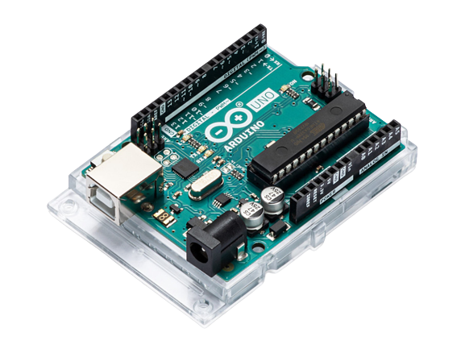
Single-Board Microcontroller
Single-Board microcontrollers, or simple board controller, are microcontrollers integrated with their support component into a single printed circuit board (pcb). Example include Arduino, NodeMCU and other
While controller board are relatively easier to embed and integrated inti other system, there are limited by capabilities of the board, and we must learn its own interface and related system(Arduino IDE, Arduino language)
Microprocessor chip
Digital
input/output
pins
USB port
Analog input pins
DC Power Jack
Miscellaneous
(resistors , capacitors,
wiring, reset button ,etc.)

Slide 4
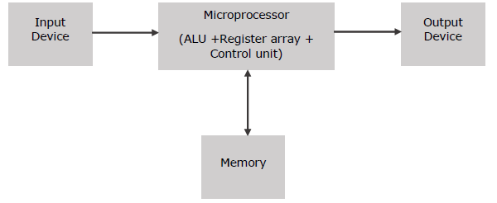
microcontroller

Slide 5



IDE software
Integrated Development Environment (IDE) is a software tool that provides an integrated environment for writing, editing, and developing code.
Why we need IDE? What an IDE do?
To get started, download thonny
*Add board manager URL to use ESP32-cam https://dl.espressif.com/dl/package_esp32_index.json

Slide 6
Hardware-software interface
The process of linking software program and hardware component, such as sensor, actuator, mechanism, and machine. The program talk to these hardware component through the controller. That is why this interface is also known as controller interfacing. Also the program written here is known as the controller program
Program
Controller
hardware

Slide 7
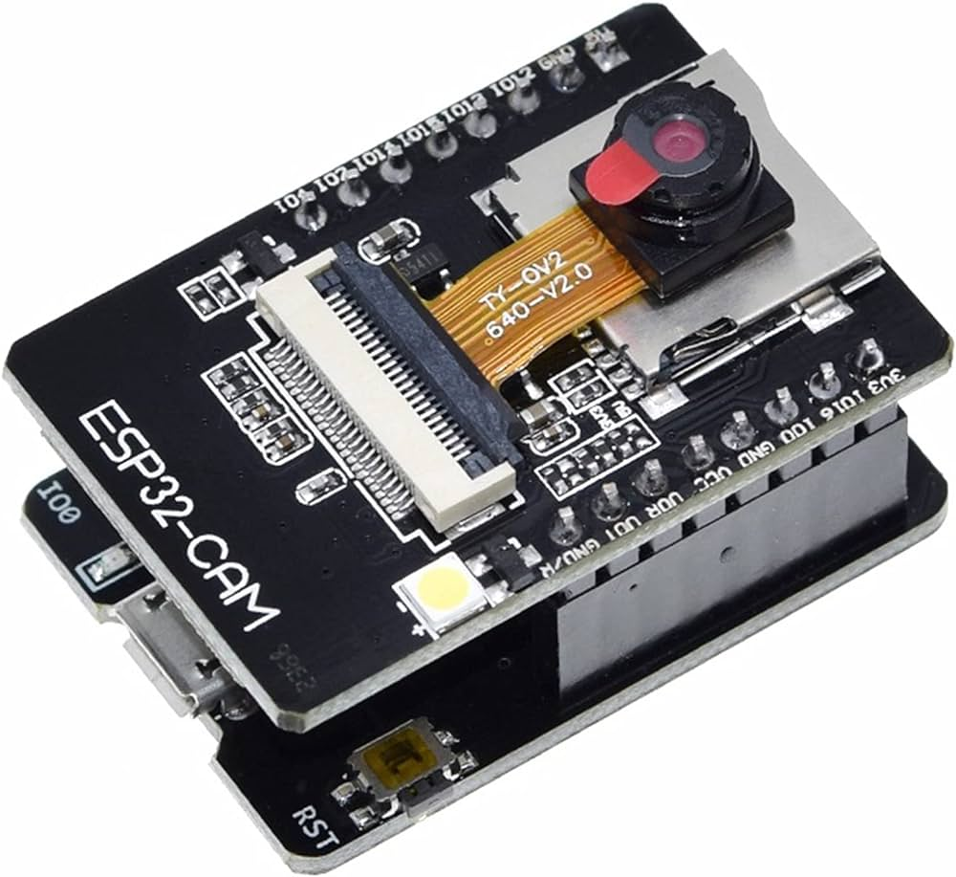
Why we use ESP32 cam
Processors:
CPU: Xtensa dual-core 32-bit LX6 microprocessor,
Processors:
CPU: Xtensa dual-core 32-bit LX6 microprocessor,
Memory:
520 KB SRAM
4MB External PSRAM
4MB internal flash memory
Supports microSD card
Wireless connectivity:
Wi-Fi: 802.11 b/g/n
Bluetooth: v4.2
Power management:
Internal low-dropout regulator
Individual power domain for RTC
5μA deep sleep current
Wake up from GPIO interrupt, timer, ADC measurements.
Camera:
2 Megapixel OV2640 sensor
Built-in flash LED
Support many camera sensors

Slide 8
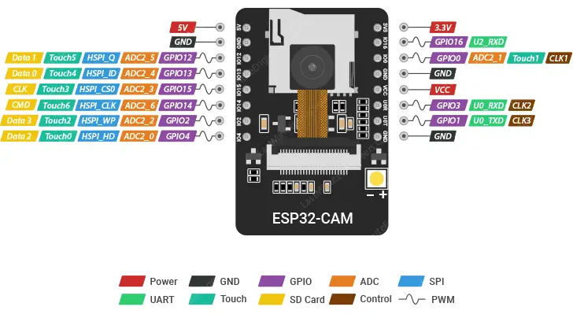
Esp32 cam pinout

Slide 9
Lets program a simple code
blink

Slide 10
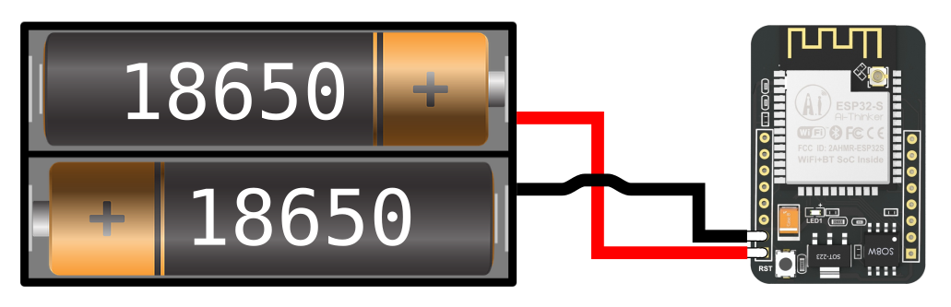
How to connect esp32-cam with battery

Slide 11
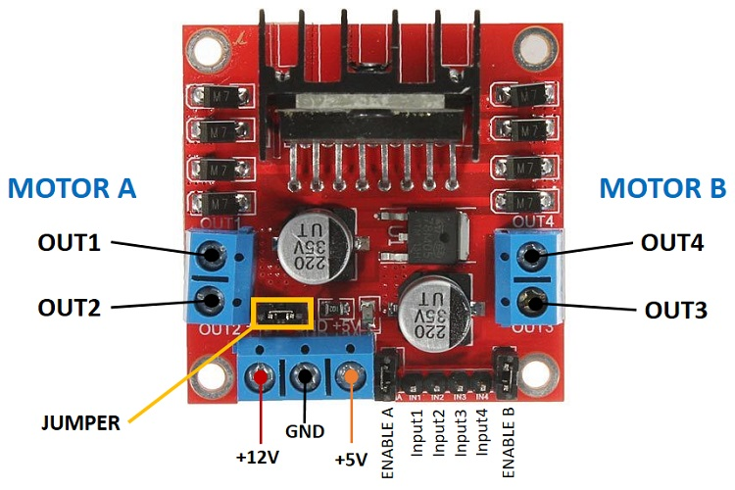
Understand how motor driver work

Slide 12
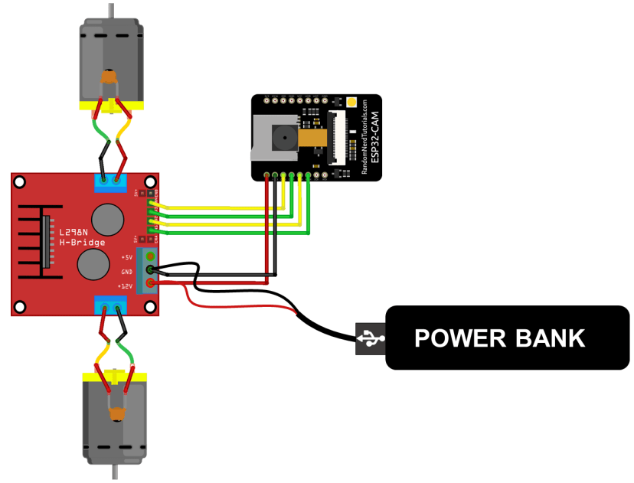
How to connect motor with esp32-cam

Slide 13
How to connect motor with esp32-cam
esp32-cam | Motor driver | Battery | Ir sensor | Ultrasonic sensor | servo
5V | 5V | 5V | 5V | 5V | 5V
GND | GND | GND | GND | GND | GND
PWM(GPIO12) | ENA
PWM(GPIO13) | ENB
DIR(GPIO15) | IN1
DIR(GPIO14) | IN2
DIR(GPIO2) | IN3
DIR(GPIO3) | IN4
(GPIO0) |  |  | IR1 | TRG | PIN
(GPIO16) |  |  | IR2 | ECHO

Slide 14
Lets build our robot and make code:
Forward()
REVERSE()
LEFT()
RIGHT()

Slide 15
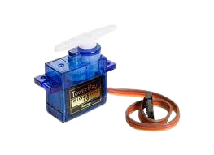
servo
What is a servo?
A servo is a small device that can rotate or move to a specific position based on control signals.
Why we use servo?
Servos are used to precisely control the position or movement of objects in various applications such as robotics, automation, remote control systems, and model making.

Slide 16
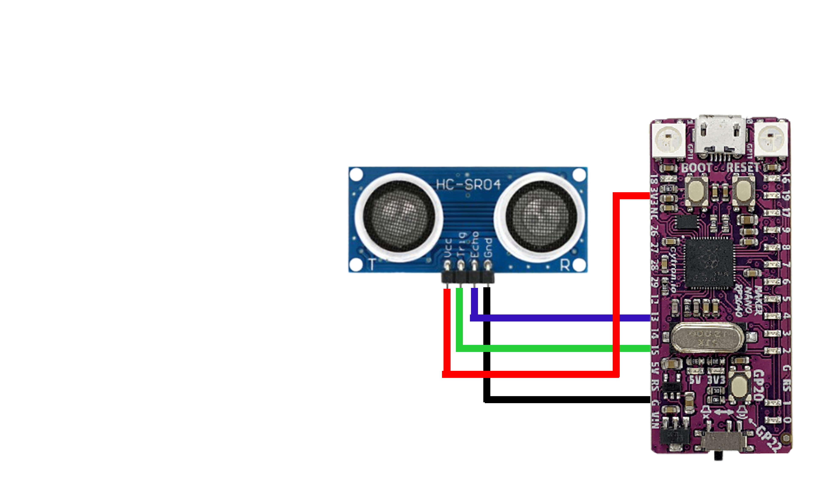
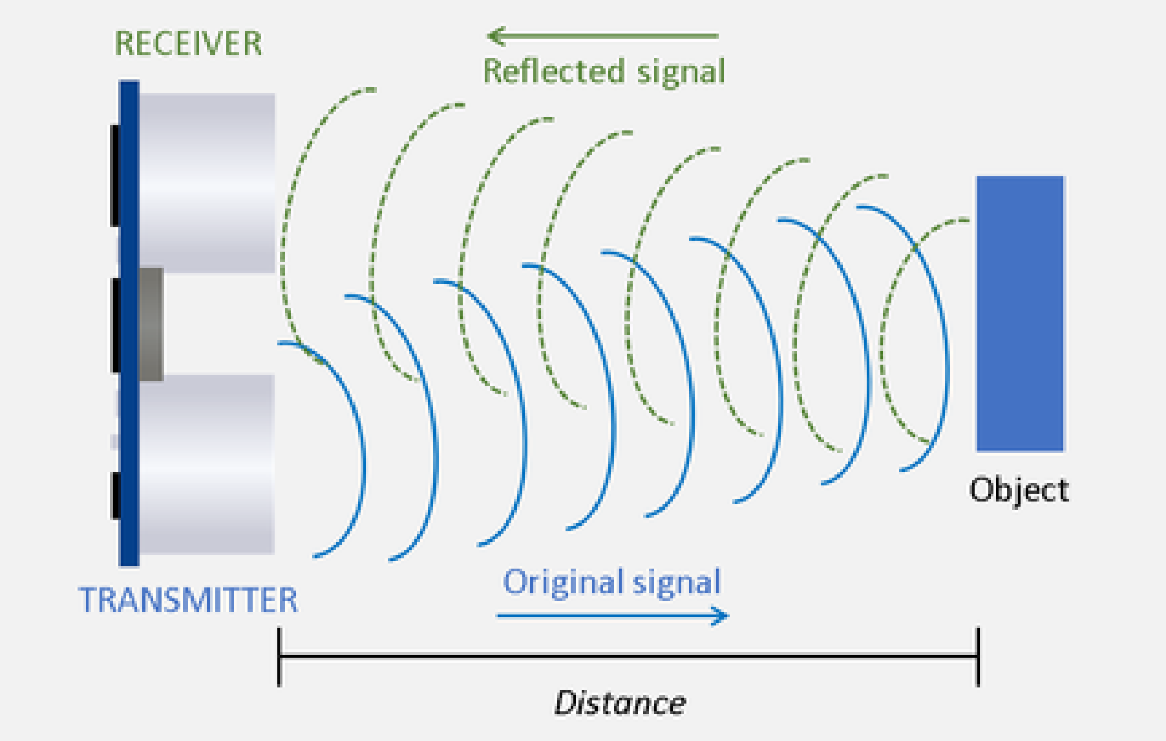
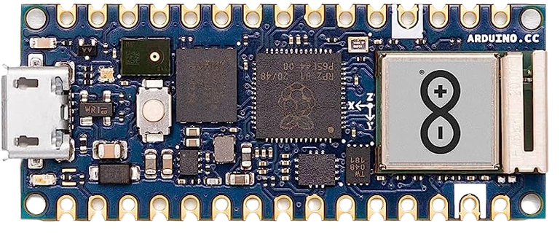
Interfacing : Ultrasonic sensor
What is an Ultrasonic Sensor? An ultrasonic sensor is an instrument that measures the distance to an object using ultrasonic sound waves. An ultrasonic sensor uses a transducer to send and receive ultrasonic pulses that relay back information about an object's proximity.
VCC = 3V3
GND = GND
ECHO = 13
TRIG = 15

Slide 17
LETS MAKE DISTANCE MEASUREMENT USING ULTRASONIC SENSOR:

Slide 18
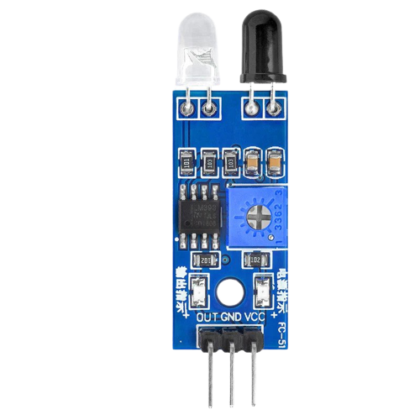
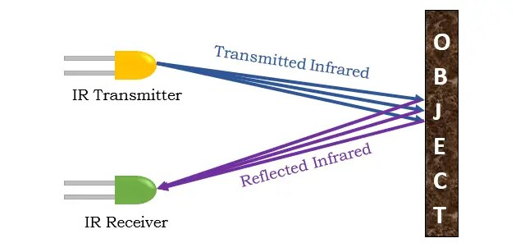
Interfacing : IR sensor
An IR (infrared) sensor is an electronic device that detects infrared radiation emitted by objects. It works by utilizing the properties of infrared light to sense proximity or motion. When an object is present, the sensor detects the infrared radiation it emits and triggers a response or provides relevant data.

Slide 19
Lets build black and white detection using ir sensor

Slide 20
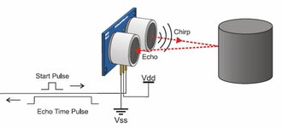
Project 1 : Building an Obstacle Avoidance Robot
Obstacle Avoiding Robot is an intelligent device that can automatically sense the obstacle in front of it and avoid them by turning itself in another direction.

Slide 21
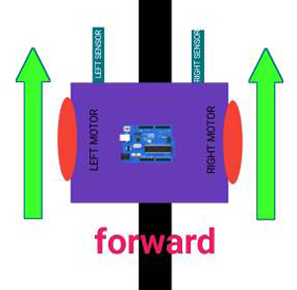
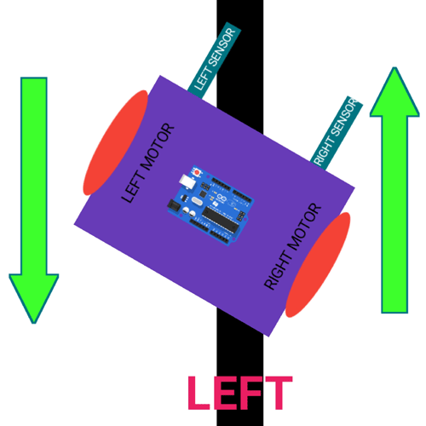
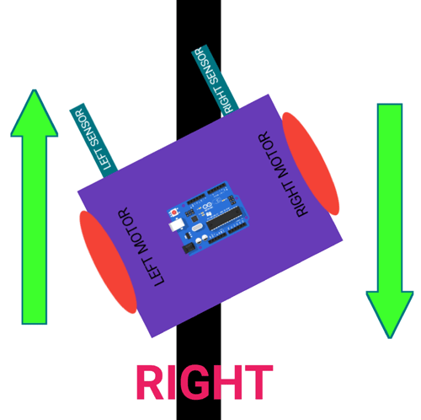
Project 2 : Line Follower Robot
Line Follower Robot (LFR) is a simple autonomously guided robot that follows a line drawn on the ground to either detect a dark line on a white surface or a white line on a dark.
If both sensor did not see the dark line, move forward
If left sensor did see the dark line, move right
If right sensor did see the dark line, move left

